Slide 1

Project Presentation
Max Chis

Slide 2

Methodology
Data exploration with emphasis on variable correlation, relationship of variable values with event probability and continuous output
Regression and Classification Models trained, including:
Linear and Quadratic Additive
All pairwise interactions
Interactions of splines of selected variables
Elastic Net
K Nearest Network
Support Vector Machine
Gradient Boosted Tree
Random Forest
Neural Networks

Slide 3
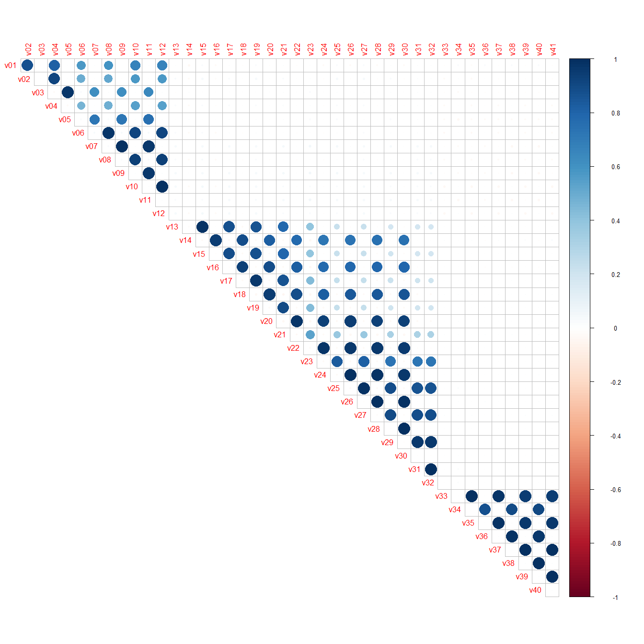
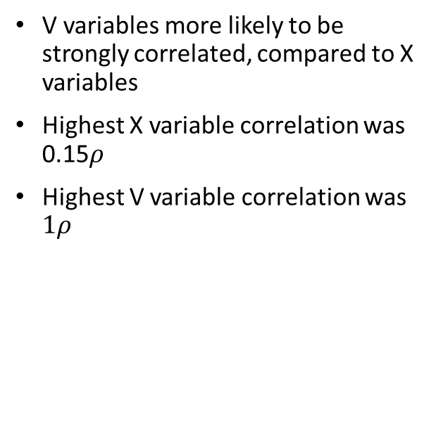
Variable Correlation
V variables more likely to be strongly correlated, compared to X variables
Highest X variable correlation was 0.15$ρ$
Highest V variable correlation was $1ρ$

Slide 4
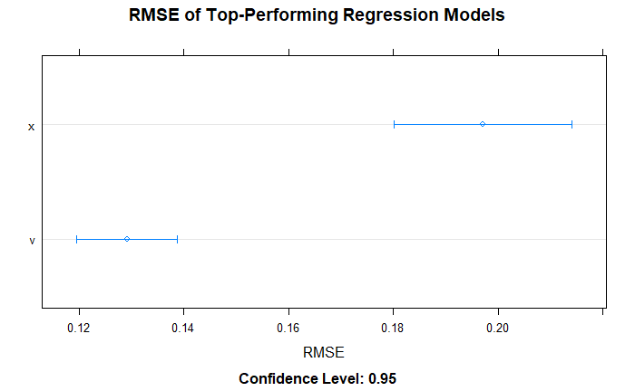
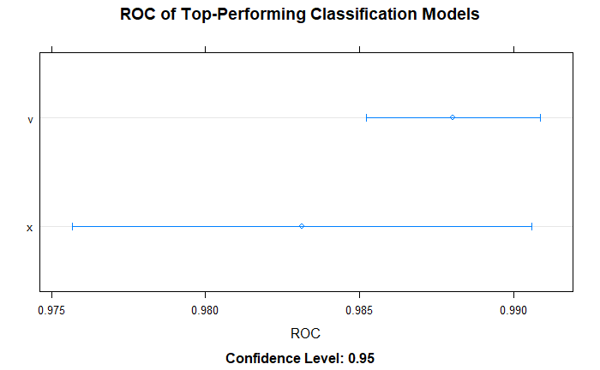
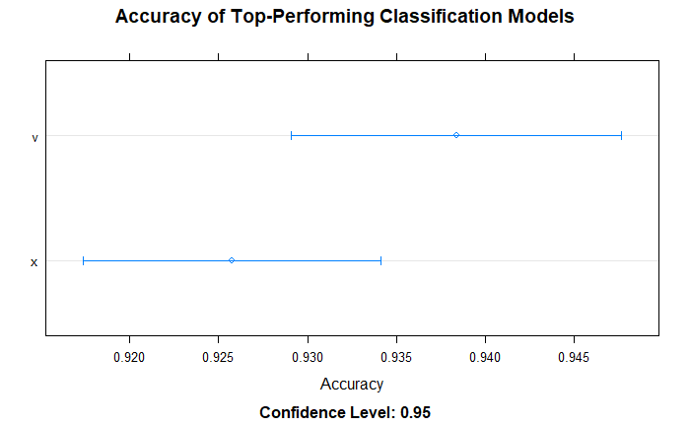
Comparing Performance Between V and X Models
Top-performing V model outperformed top-performing X model in Regression
Reverse is true for classification in terms of Accuracy
Comparable performance for classification in terms of ROC

Slide 5
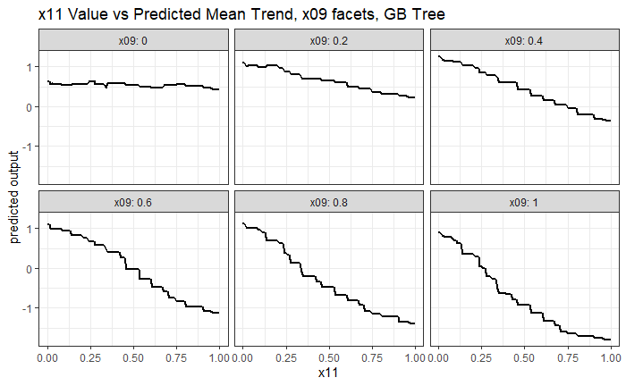
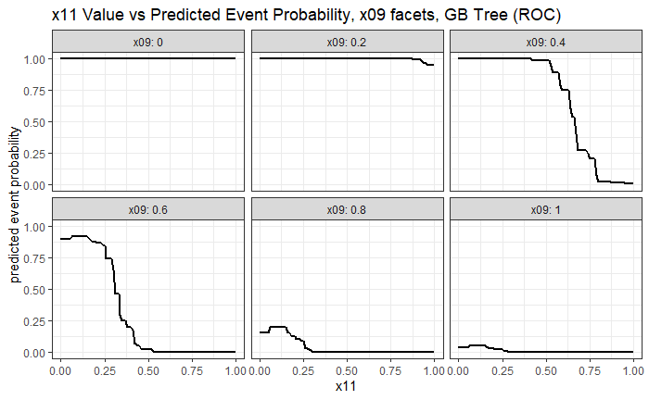
Best-Performing Model – X Variables
Continuous Output (Regression)
Event Probability (Classification)
Model fitted using gradient-boosted tree.
Maximizing x09 and x11 minimizes continuous output and error probability

Slide 6
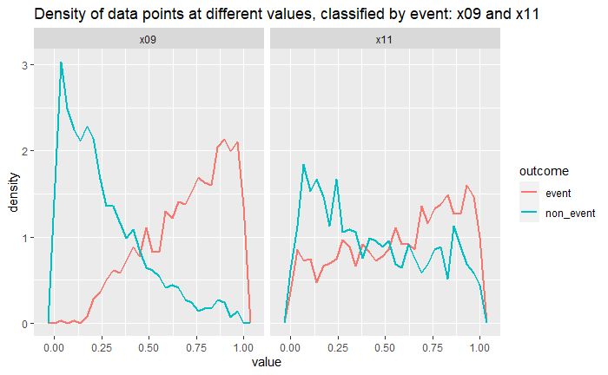
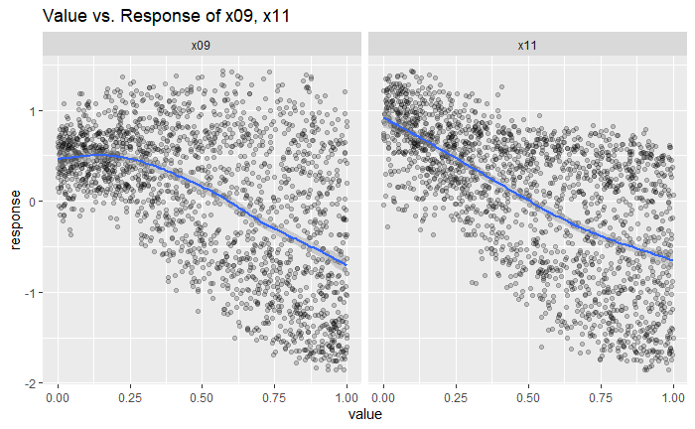
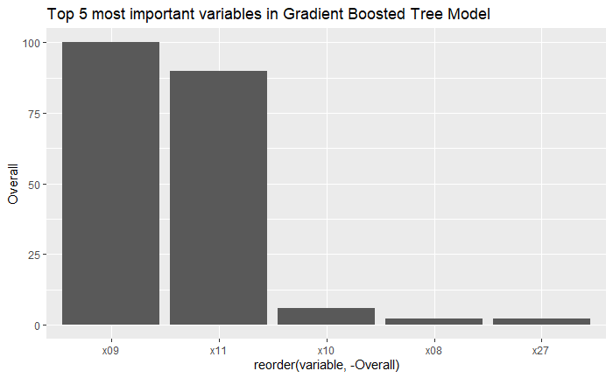
Variable Importance – X Variables
X09 and x11 consistently found to be most important variables
All other variables have marginal importance to model.
Importance of X09 and X11 consistently found across different models.

Slide 7
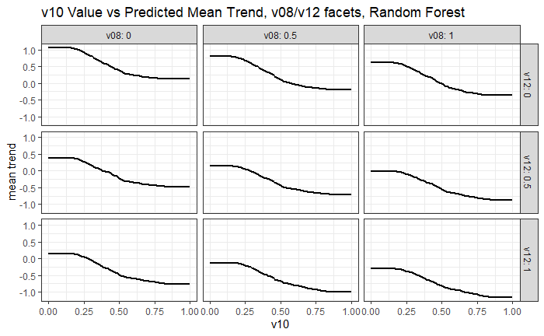
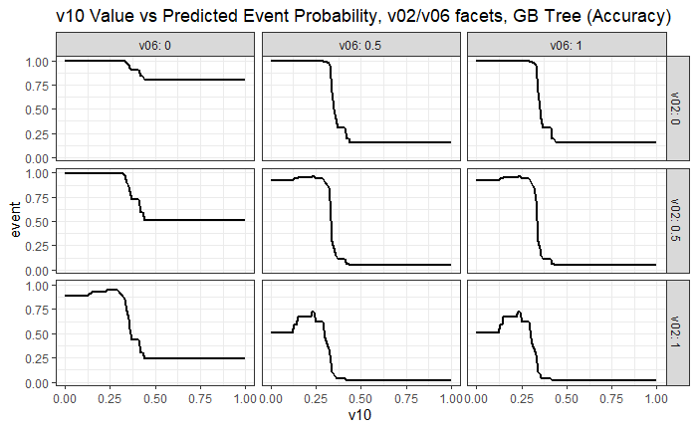
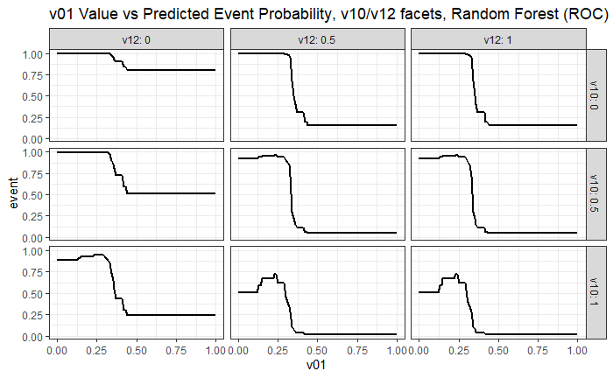
Best Performing Model – V Variables
Gradient-Boosted tree maximized Accuracy (in Classification) and RMSE (in Regression)
Random Forest maximized ROC scores in Classification
Maximizing v01,v02, v06, v08, v10, v12 minimizes continuous output and event probability.

Slide 8
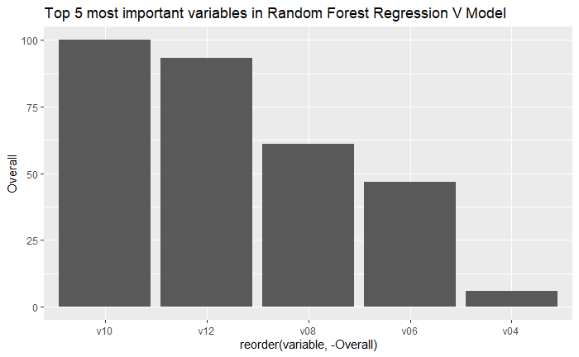
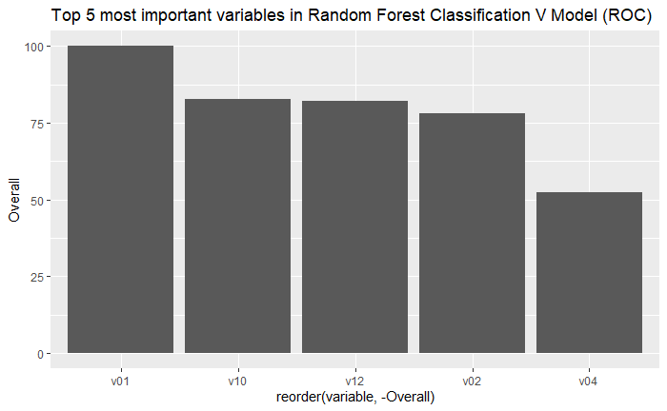
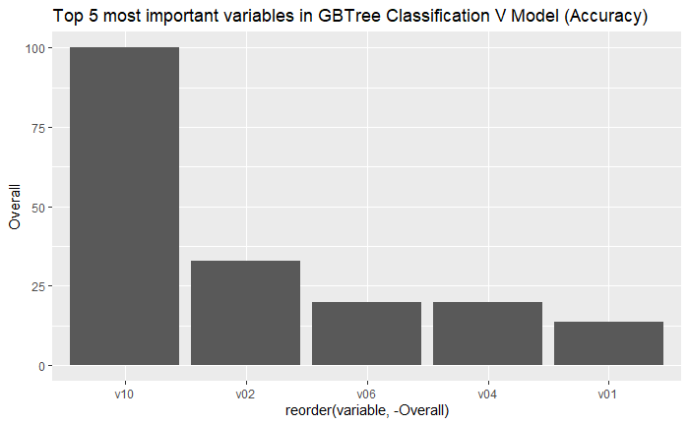
Variable Importance – V Variables
V models disagreed more than X models on which variables were most important
Consistent top-performers included v01, v02, v06, v08, v10, and v12

Slide 9
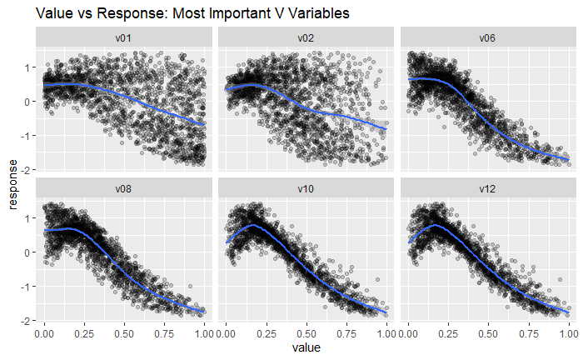
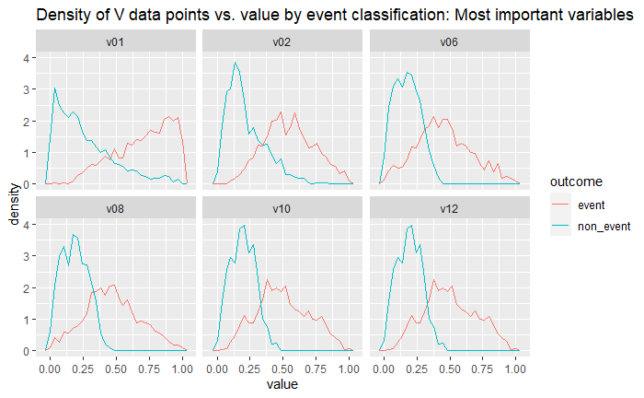
Plotting Most Important V Variables

Slide 10
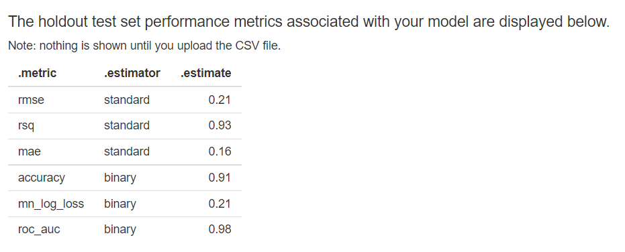
Performance on Holdout Set
X Holdout Set (GBTree) utilized

